Slide 1

Face Mask Monitoring and Notification System Using Computer Vision and Deep Learning
UNDER THE GUIDANCE OF
MR. AMIT KUMAR RAI
ASSISTANT PROFESSOR,
DEPARTMENT OF ELECTRONICS AND COMMUNICATION ENGINEERING,
ASANSOL ENGINEERING COLLEGE

Slide 2
OUR TEAM
SANDIP GHOSH - 10800318050
RUPAM DASGUPTA - 10800318055
ROUNAK BANERJEE - 10800318057
SAPTARSHI BANERJEE – 10800318048
RENESA CHAKRABORTY – 10800318061
SHOUVIK NEOGI - 10800318039

Slide 3
PRESENTATION OUTLINE
PROBLEM STATEMENT
INTRODUCTION
MOTIVATION
LITERATURE SURVEY
PROJECT FLOWCHART
WORK OUTLINE
CONCLUSION

Slide 4
PROBLEM STATEMENT
MODEL STRUCTURE OF FACE MASK MONITORING AND NOTIFICATION SYSTEM USING COMPUTER VISION AND DEEP LEARNING.

Slide 5
INTRODUCTION
THE CORONA VIRUS COVID-19 PANDEMIC IS CAUSING A GLOBAL HEALTH CRISIS SO THE EFFECTIVE PROTECTION METHODS IS WEARING A FACE MASK IN PUBLIC AREAS ACCORDING TO THE WORLD HEALTH ORGANIZATION (WHO). THE COVID-19 PANDEMIC FORCED GOVERNMENTS ACROSS THE WORLD TO IMPOSE LOCKDOWNS TO PREVENT VIRUS TRANSMISSIONS. REPORTS INDICATE THAT WEARING FACEMASKS WHILE AT WORK CLEARLY REDUCES THE RISK OF TRANSMISSION. WE WILL USE THE DATASET TO BUILD A COVID-19 FACE MASK DETECTOR WITH COMPUTER VISION USING PYTHON, OPENCV, AND TENSORFLOW AND KERAS. IN OUR PROPOSED SYSTEM WE WILL USE LIVE VIDEO STREAM AND FINALLY IN OUTPUT IT MARKS THE PERSON WHO IS NOT WEARING FACE MASK. OUR GOAL IS TO IDENTIFY WHETHER THE PERSON ON IMAGE/VIDEO STREAM IS WEARING A FACE MASK OR NOT WITH THE HELP OF COMPUTER VISION AND DEEP LEARNING. IF THE PERSON IS NOT WEARING THE MASK THEN A SMS ALERT IS SENT TO THE PERSON’S MOBILE.[1]

Slide 6
MOTIVATION
We all know that because of the covid-19 in 2020 we have faced a lot of problems. So it's a need of the day that we must wear mask while going anywhere and also ensure that everybody wear mask. That's why these kind of algorithm have been developed with the passage of time and many researchers are also working on it Such that in order to deploy these kind of deep learning architecture on the surveillance camera so that if anyone among the crowd is not wearing the mask so he/she can be identified.[2]

Slide 7
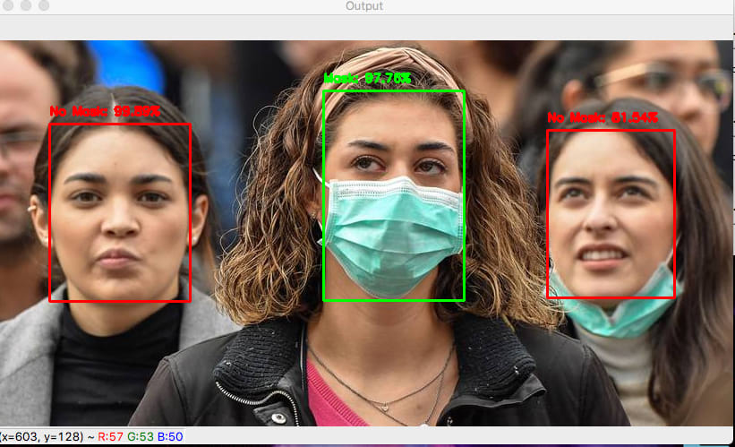
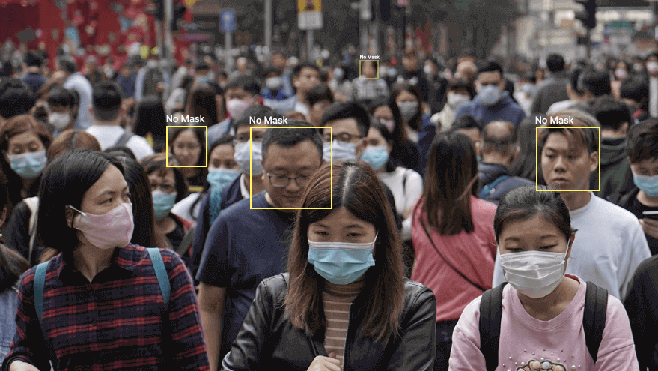
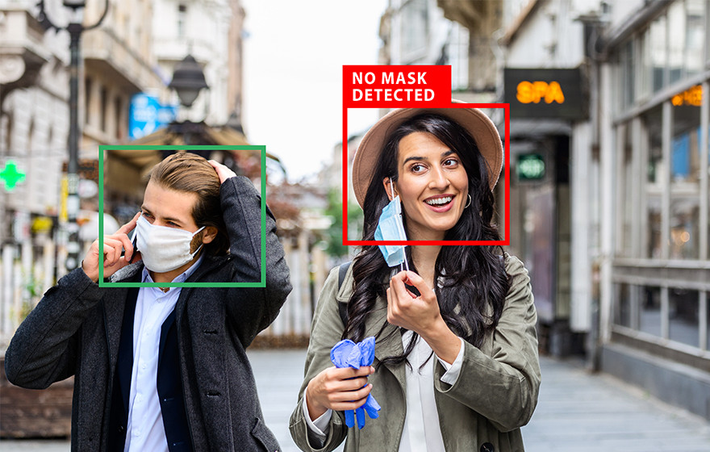

Slide 8
LITERATURE SURVEY
The face MASK detection modeL is based on computer vision and deep learning. The model is integration between deep learning and classical machine learning techniques with OpenCV, tensor flow and Keras. We have used deep transfer leArNINg for feature extractions and combined it with three classical machine learning algorithms. We introduced a comparison between them to find the most suitable algorithm that achieved the highest accuracy and consumed the least time in the process of training and detection.
There are several approaches THAT are used for facial masks detection. For instance, [3] used electromagnetic and radiometry techniques for facial masks detection. [4] employed deep neural networks (ANN) using machine learning techniques in Facial Masks detection. [5] Neural Networks are used to exacted information from ultrasound to classify the abnormal lesions. [6] presented a face feature detection method based on Ultrasound RF Time series and SVM Classifier. The characteristics curve of 0.86 using support vector machine (SVM) and 0.81using RF classification algorithm on 22 subjects was determined.

Slide 9
PROJECT FLOWCHART

Slide 10
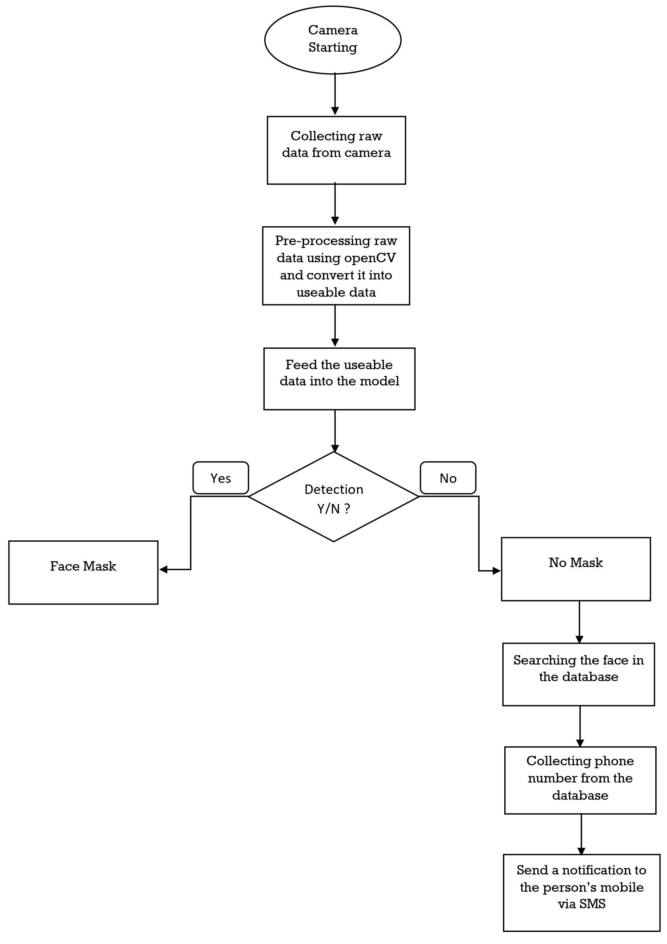

Slide 11
TECH TOOLS USED

Slide 12





Google colab

Slide 13
WORK OUTLINE
IMAGE PROCESSING & DATA PREPARATION
MODEL MAKING : >> MODEL_0 (DENSE_NET ARCHITECTURE)
>>MODEL_1 (MOBILE_NET ARCHITECTURE)
>>MODEL_2 (RES_NET ARCHITECTURE)
>>MODEL_3 (NAS_NET ARCHITECTURE)
3. MODEL PREDICTION

Slide 14
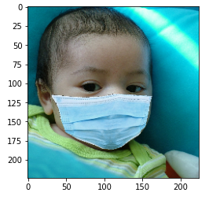
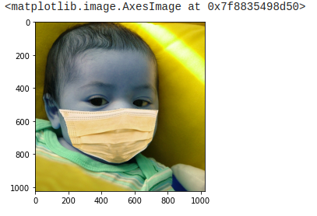
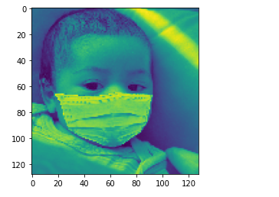
IMAGE PROCESSING & DATA PREPARATION
MODIFIED IMAGE (RGB)
IMAGE PIXEL SIZE = 224 x 224
ORIGINAL IMAGE
IMAGE PIXEL SIZE = 1024 x 1024
MODIFIED IMAGE (GRAY SCALE)
IMAGE PIXEL SIZE = 128 x 128

Slide 15
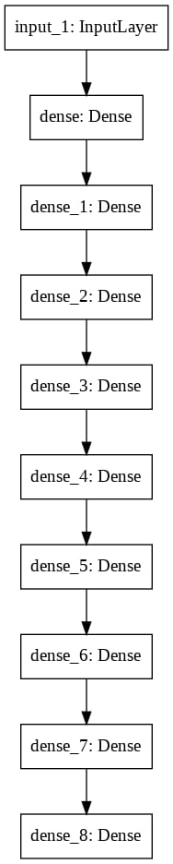
DENSE_NET ARCHITECTURE
NAME – MODEL_0
A DENSE NETWORK IS A NETWORK IN WHICH THE NUMBER OF LINKS OF EACH NODE IS CLOSE TO THE MAXIMAL NUMBER OF NODES. EACH NODE IS LINKED TO ALMOST ALL OTHER NODES. THE TOTAL CONNECTED CASE IN WHICH EXACTLY EACH NODE IS LINKED TO EACH OTHER NODE IS CALLED A COMPLETELY CONNECTED NETWORK.[7]
TEST ACCURACY – 86%

Slide 16
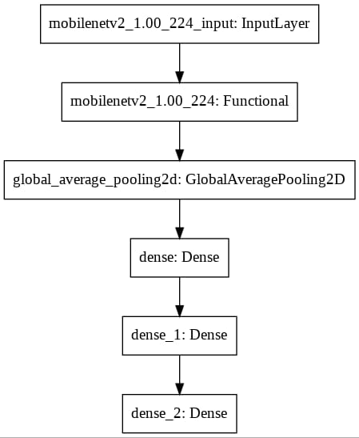
mobile_NET ARCHITECTURE
NAME – MODEL_1
THE MOBILENET WAS PROPOSED AS A DEEP LEARNING MODEL BY ANDREW G. HOWARD ET AL OF GOOGLE RESEARCH TEAM IN THEIR RESEARCH WORK ENTITLED “MOBILENETS: EFFICIENT CONVOLUTIONAL NEURAL NETWORKS FOR MOBILE VISION APPLICATIONS”. THIS MODEL WAS PROPOSED AS A FAMILY OF MOBILE-FIRST COMPUTER VISION MODELS FOR TENSORFLOW, DESIGNED TO EFFECTIVELY MAXIMIZE ACCURACY WHILE BEING MINDFUL OF THE RESTRICTED RESOURCES FOR AN ON-DEVICE OR EMBEDDED APPLICATION.[8]
TEST ACCURACY – 97%

Slide 17
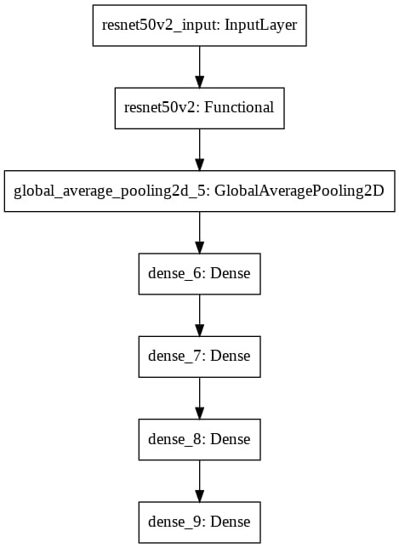
res_NET ARCHITECTURE
NAME – MODEL_2
A RESIDUAL NEURAL NETWORK (RESNET) IS AN ARTIFICIAL NEURAL NETWORK (ANN) OF A KIND THAT BUILDS ON CONSTRUCTS KNOWN FROM PYRAMIDAL CELLS IN THE CEREBRAL CORTEX. RESIDUAL NEURAL NETWORKS DO THIS BY UTILIZING SKIP CONNECTIONS, OR SHORTCUTS TO JUMP OVER SOME LAYERS.[9]
TEST ACCURACY – 99%

Slide 18
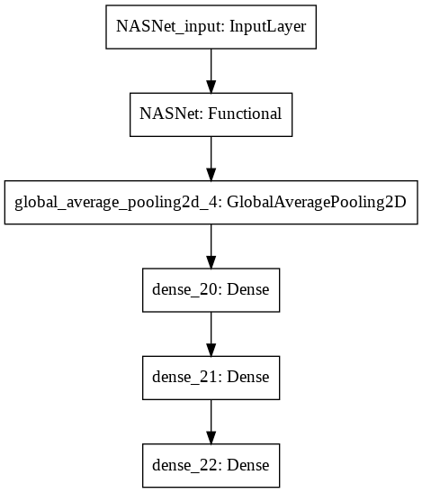
nas_NET ARCHITECTURE
NAME – MODEL_3
NEURAL ARCHITECTURE SEARCH (NAS) IS A TECHNIQUE FOR AUTOMATING THE DESIGN OF ARTIFICIAL NEURAL NETWORKS (ANN), A WIDELY USED MODEL IN THE FIELD OF MACHINE LEARNING. NAS HAS BEEN USED TO DESIGN NETWORKS THAT ARE ON PAR OR OUTPERFORM HAND-DESIGNED ARCHITECTURES. METHODS FOR NAS CAN BE CATEGORIZED ACCORDING TO THE SEARCH SPACE, SEARCH STRATEGY AND PERFORMANCE ESTIMATION STRATEGY USED: THE SEARCH SPACE DEFINES THE TYPE(S) OF ANN THAT CAN BE DESIGNED AND OPTIMIZED. [10]
TEST ACCURACY – 84%

Slide 19
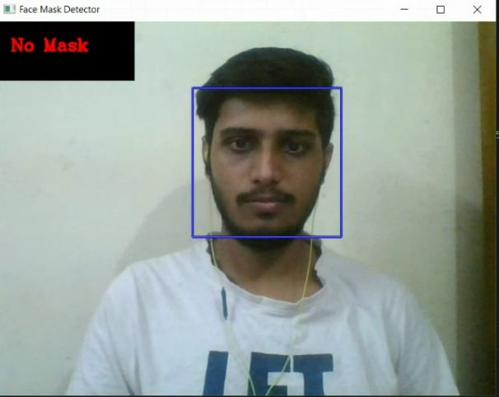
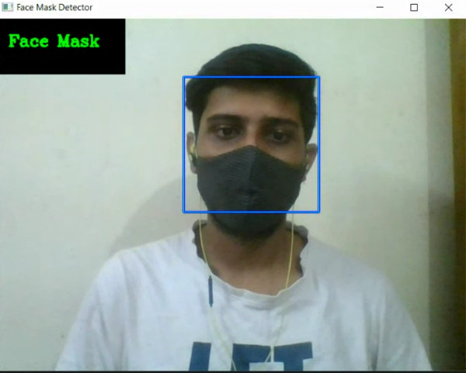
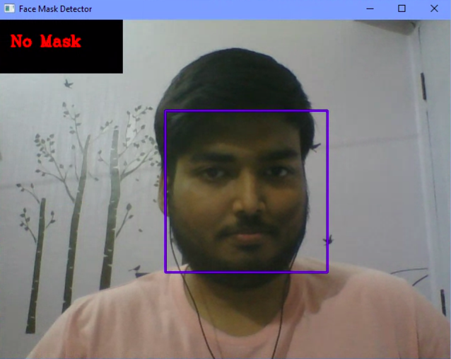
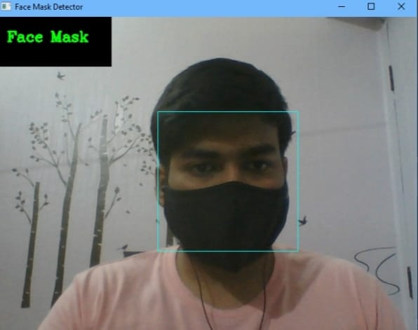
OUTPUT

Slide 20
MODEL ANALYSIS
POINTS | DENSE_NET ARCHITECTURE | MOBILE_NET ARCHITECTURE | RES_NET ARCHITETURE | NAS_NET ARCHITECTURE
DEFINITION | A DENSE NETWORK IS A NETWORK IN WHICH THE NUMBER OF LINKS OF EACH NODE IS CLOSE TO THE MAXIMAL NUMBER OF NODES. | MOBILENET IS A STREAMLINED ARCHITECTURE THAT USES DEPTHWISE SEPARABLE CONVOLUTIONS TO CONSTRUCT LIGHTWEIGHT DEEP CONVOLUTIONAL NEURAL NETWORKS AND PROVIDES AN EFFICIENT MODEL FOR MOBILE AND EMBEDDED VISION APPLICATIONS. | A RESIDUAL NEURAL NETWORK (RESNET) IS AN ARTIFICIAL NEURAL NETWORK (ANN) OF A KIND THAT BUILDS ON CONSTRUCTS KNOWN FROM PYRAMIDAL CELLS IN THE CEREBRAL CORTEX. RESIDUAL NEURAL NETWORKS DO THIS BY UTILIZING SKIP CONNECTIONS, OR SHORTCUTS TO JUMP OVER SOME LAYERS. | NEURAL ARCHITECTURE SEARCH (NAS) IS A TECHNIQUE FOR AUTOMATING THE DESIGN OF ARTIFICIAL NEURAL NETWORKS (ANN), A WIDELY USED MODEL IN THE FIELD OF MACHINE LEARNING.
NUMBER OF HIDDEN LAYERS | 8 | 154(BASE) + 3(ADDED) | 190(BASE) + 4(ADDED) | 769(BASE) + 3(ADDED)
OPTIMIZATION ALGORITHM | ADAMS ALGORITHM | ADAMS ALGORITHM | ADAMS ALGORITHM | ADAMS ALGORITHM
TEST ACCURACY | 86 % | 97 % | 99 % | 84 %
SIZE | 2.45 GB | 34.1 MB | 120 MB | 24.1 MB

Slide 21
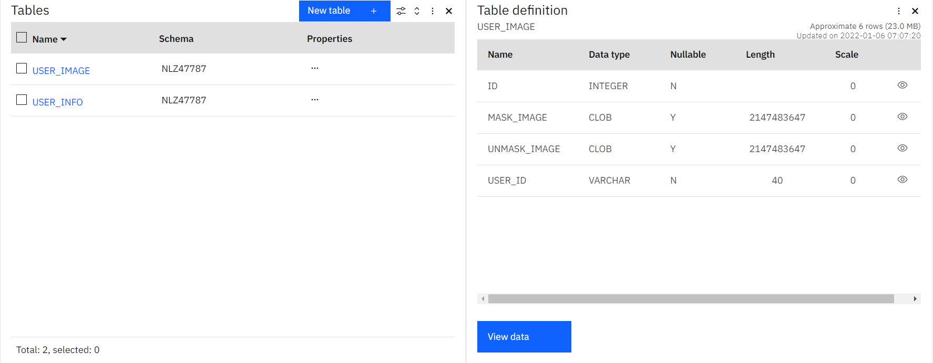
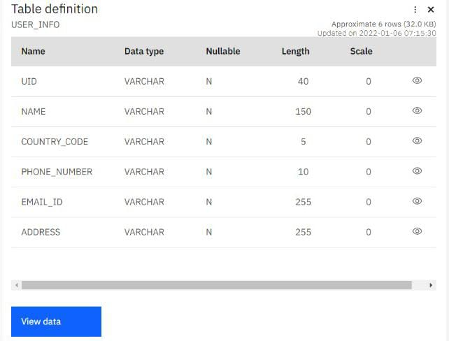
SCHEMA OF DATABASE
IBM CLOUD DATABASE

Slide 22
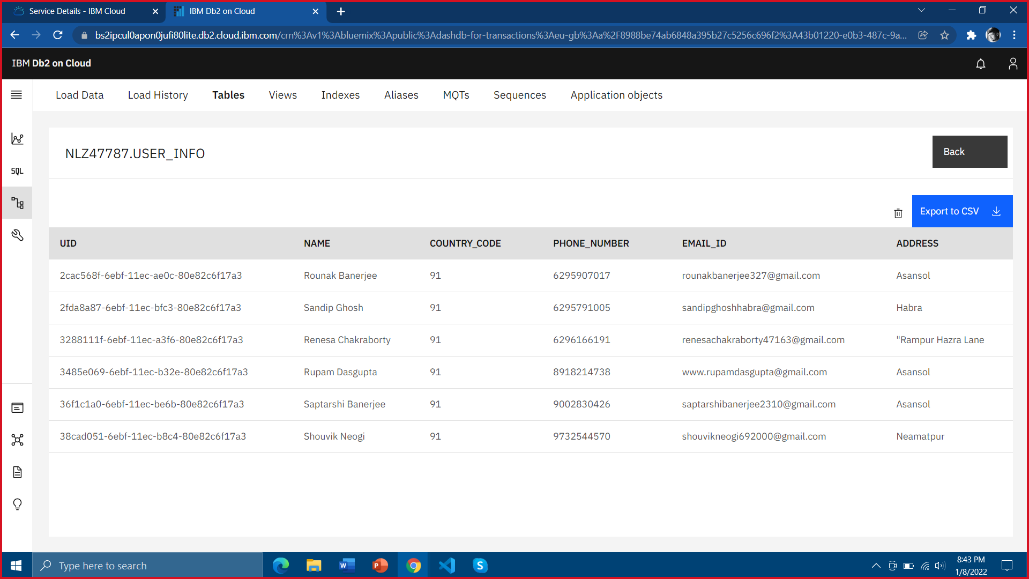
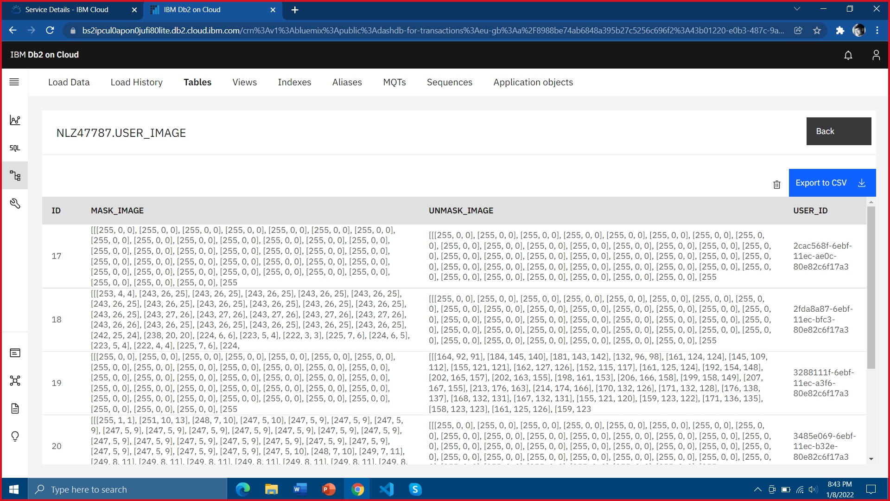
DATA STORE
Info table
USER_IMAGE table

Slide 23
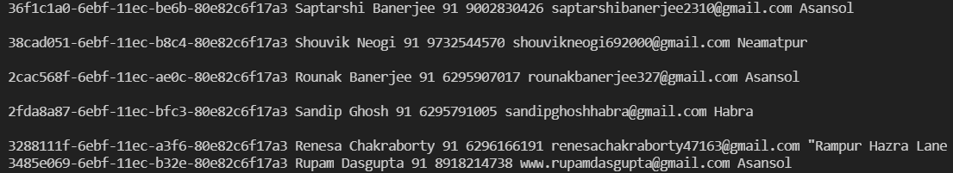
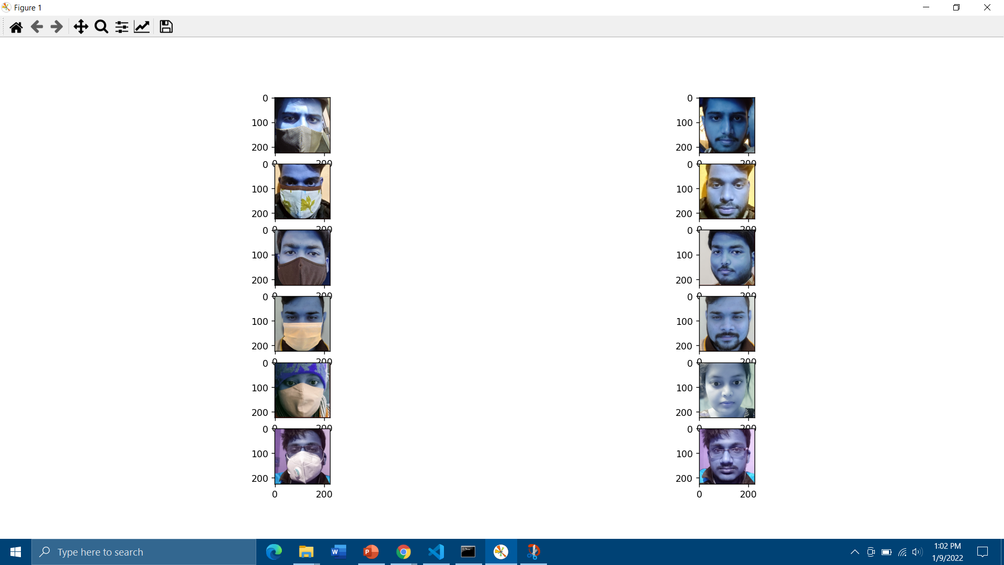
FETCHING RESULTS

Slide 24
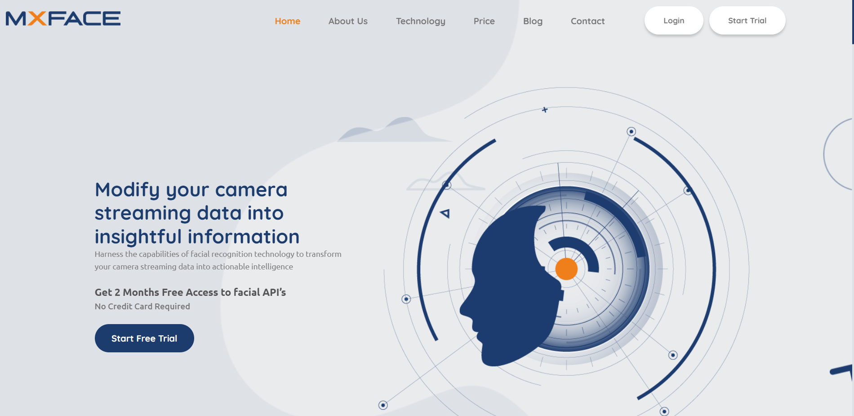
WORK IN PROGRESS
INTEGRATING API INTO OUR APPLICATION

Slide 25
Upto the first part of our project , RES NET Architecture can successfully predict the face wearing a mask or not. Raw Data is collected through the camera, then pre-processing raw data using openCV is converted into usable data and then is fed into the models. The various architectures used are DENSE NET, MOBILE NET, RES NET. Since, RES NET Architecture is giving us 99% accuracy, so this particular model is preferred.
CONCLUSION

Slide 26
REFERENCES
[1]https://www.who.int/docs/default-source/coronaviruse/situation-reports/20200816-covid-19-sitrep-209.pdf?sfvrsn=5dde1ca2_2
[2]https://www.paho.org/en/news/2-6-2020-social-distancing-surveillance-and-stronger-health-systems-keys-controlling-covid-19
[3] kepenekci, b., and akar, g. b. (2004, april). face classification with support vector machine. ieee 12th signal processing and communications applications conference, 2004. (pp. 583-586). ieee
[4] h. anandakumar and k. umamaheswari, a bio-inspired swarm intelligence technique for social aware cognitive radio handovers, computers & electrical engineering, vol. 71, pp. 925–937, oct. 2018. doi:10.1016/j.compeleceng.2017.09.016
[5] r. arulmurugan and h. anandakumar, early detection of lung cancer using wavelet feature descriptor and feed forward back propagation neural networks classifier, lecture notes in computational vision and biomechanics, pp. 103–110, 2018. doi:10.1007/978-3-319-71767-8_9.
[6] vu, n. s., and caplier, a. (2010, september). face recognition with patterns of oriented edge magnitudes. (pp. 313-326). springer, berlin, heidelberg.
[7] https://keras.io/api/layers/core_layers/dense/
[8] https://keras.io/api/applications/mobilenet/
[9] https://keras.io/api/applications/resnet/
https://www.mygreatlearning.com/blog/resnet/
[10] https://keras.io/api/applications/nasnet/
https://iq.opengenus.org/nasnet/

Slide 27
THANK YOU

